Slide 1
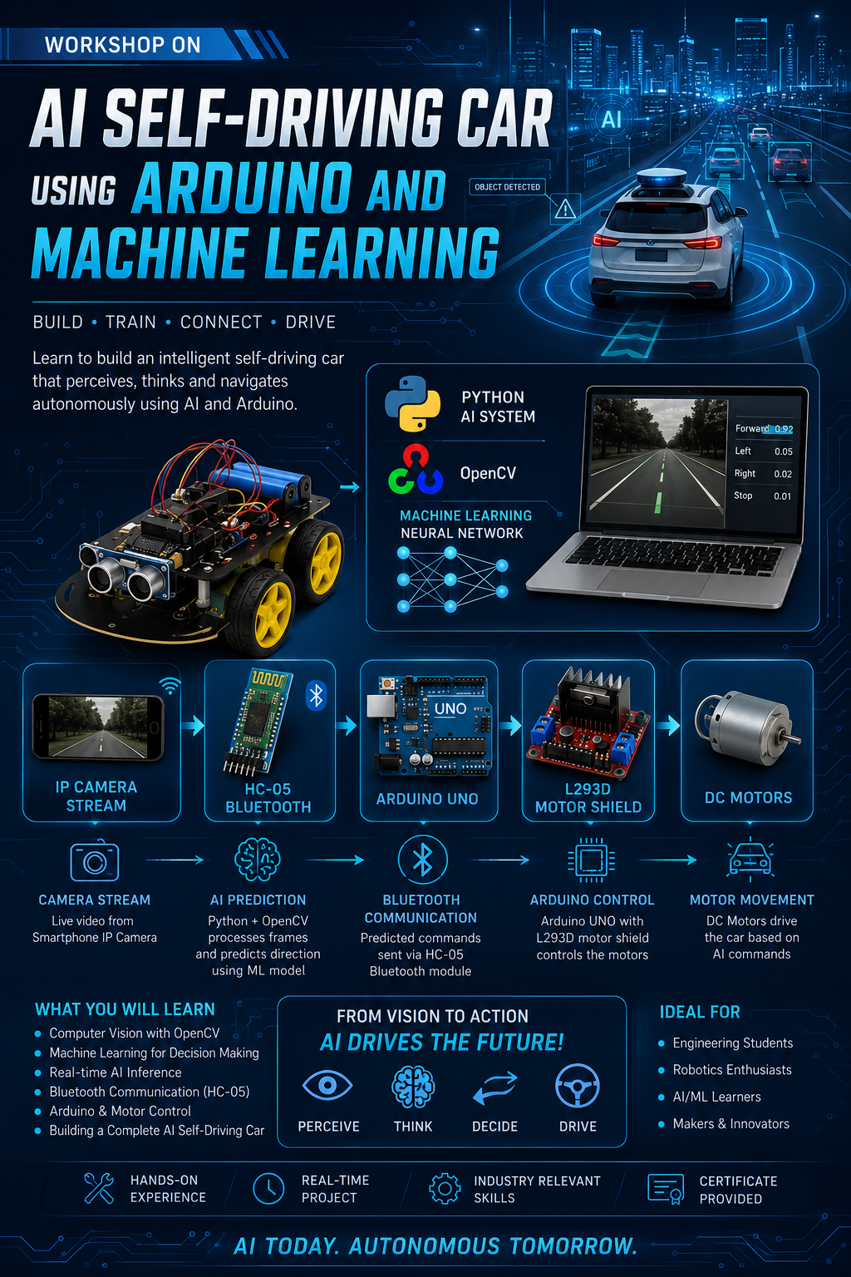
AI SELF –DRIVING CAR

Slide 2
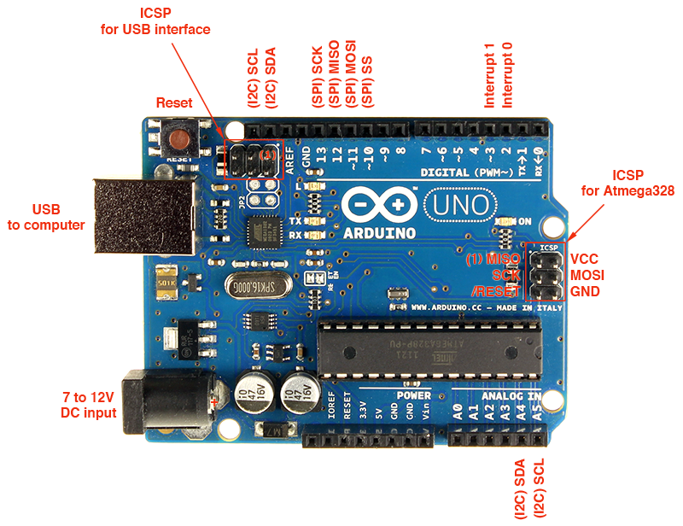
Arduino UNO
Main controller board used to process Bluetooth commands and control motors.

Slide 3
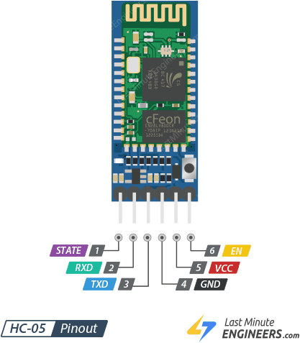
HC-05 Bluetooth Module
Used for wireless communication between mobile phone and robot.
HC-05 | Arduino
VCC | 5V
GND | GND
TXD | RX Pin
RXD | TX Pin

Slide 4
L298N Motor Driver
There are two working concepts behind controlling the speed and the direction of a DC motor. Pulse width modulation is used to control the speed of the motor. H-bridge connections are used to change the direction of the motor.
In pulse width modulation, the voltage is varied by sending a series of ON-OFF pulses.
The average voltage during the PWM depends on the duty cycle. The higher the duty cycle is, the higher the average voltage is and the lower the duty cycle is, the lower the average voltage. The relation between duty cycle and average voltage is shown in the below picture.

Slide 5
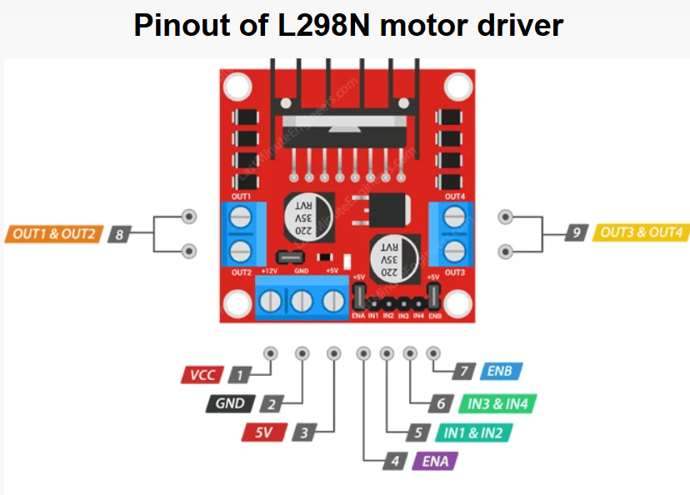
Pinout of L298N motor driver
IN1 | IN2 | Left Motor
1 | 0 | Forward
0 | 1 | Backward
IN3 | IN4 | Right Motor
1 | 0 | Forward
0 | 1 | Backward

Slide 6
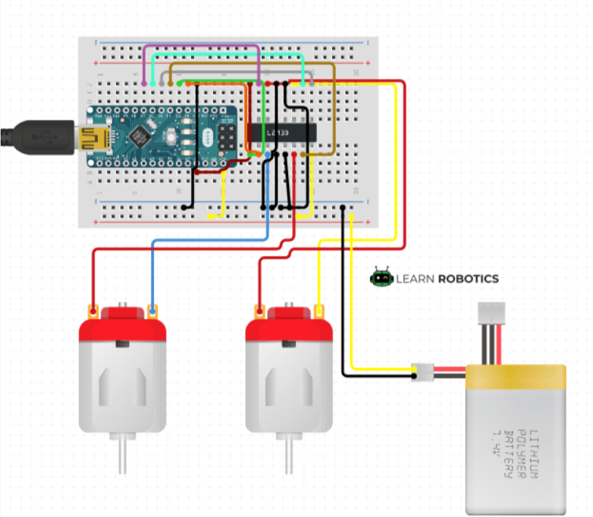
DC Motors
Two DC motors are used for robot movement and turning.

Slide 7
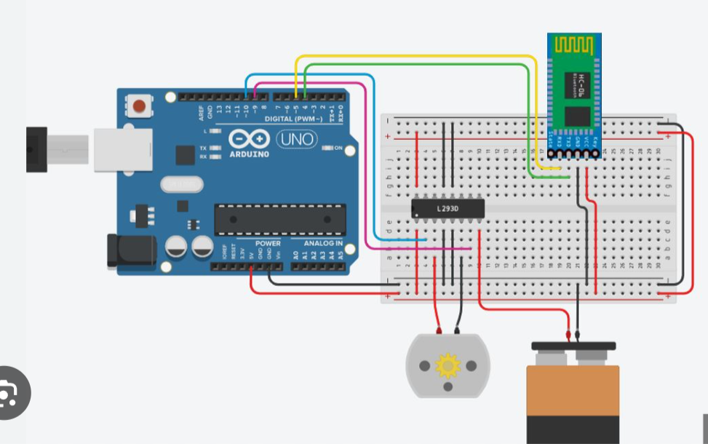
Project Workflow
Mobile App -> HC-05 -> Arduino -> Motor Shield -> DC Motors

Slide 8
Command Summary
f = Forward -Moves the robot in the forward direction by rotating both motors ahead.
l = Left -Turns the robot left by slowing/stopping one motor and rotating the other motor.
r = Right -Turns the robot right using opposite motor control logic.
s = Stop -Stops all motor movement immediately.

Slide 9
Applications
Bluetooth Robot
AI Robot
Line Follower
Obstacle Avoidance

Slide 10
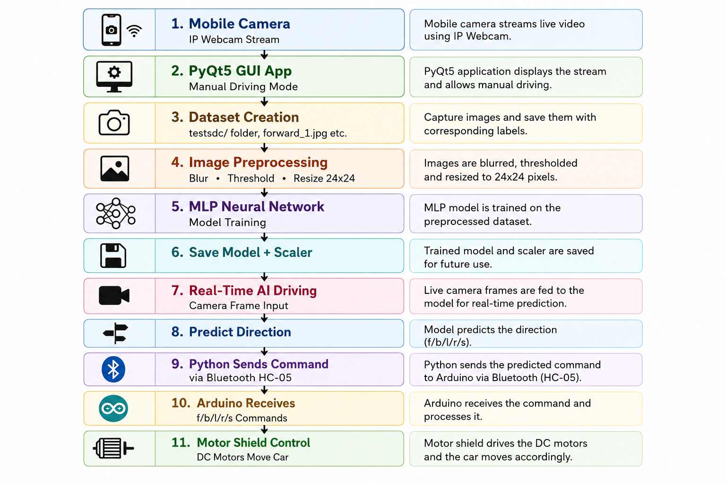
Complete Workflow Architecture

Slide 11
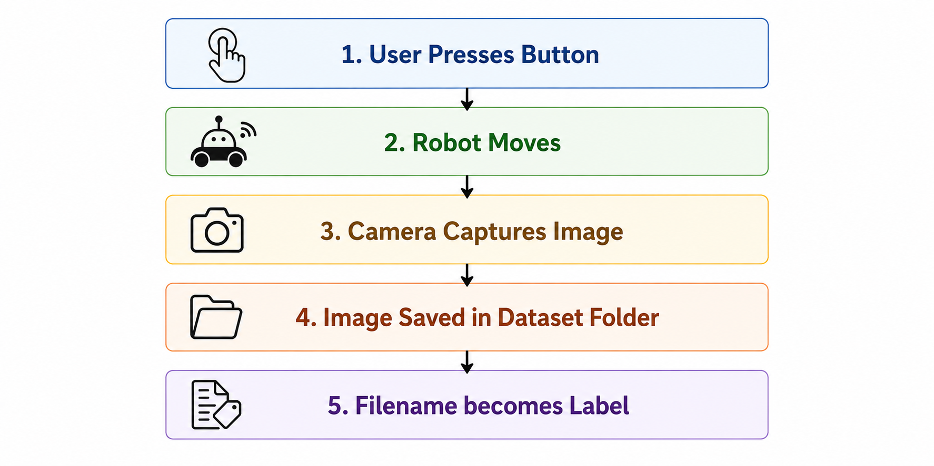
Data Collection Workflow File: PyQt5 GUI Application Purpose: Collect labeled training images for AI.

Slide 12
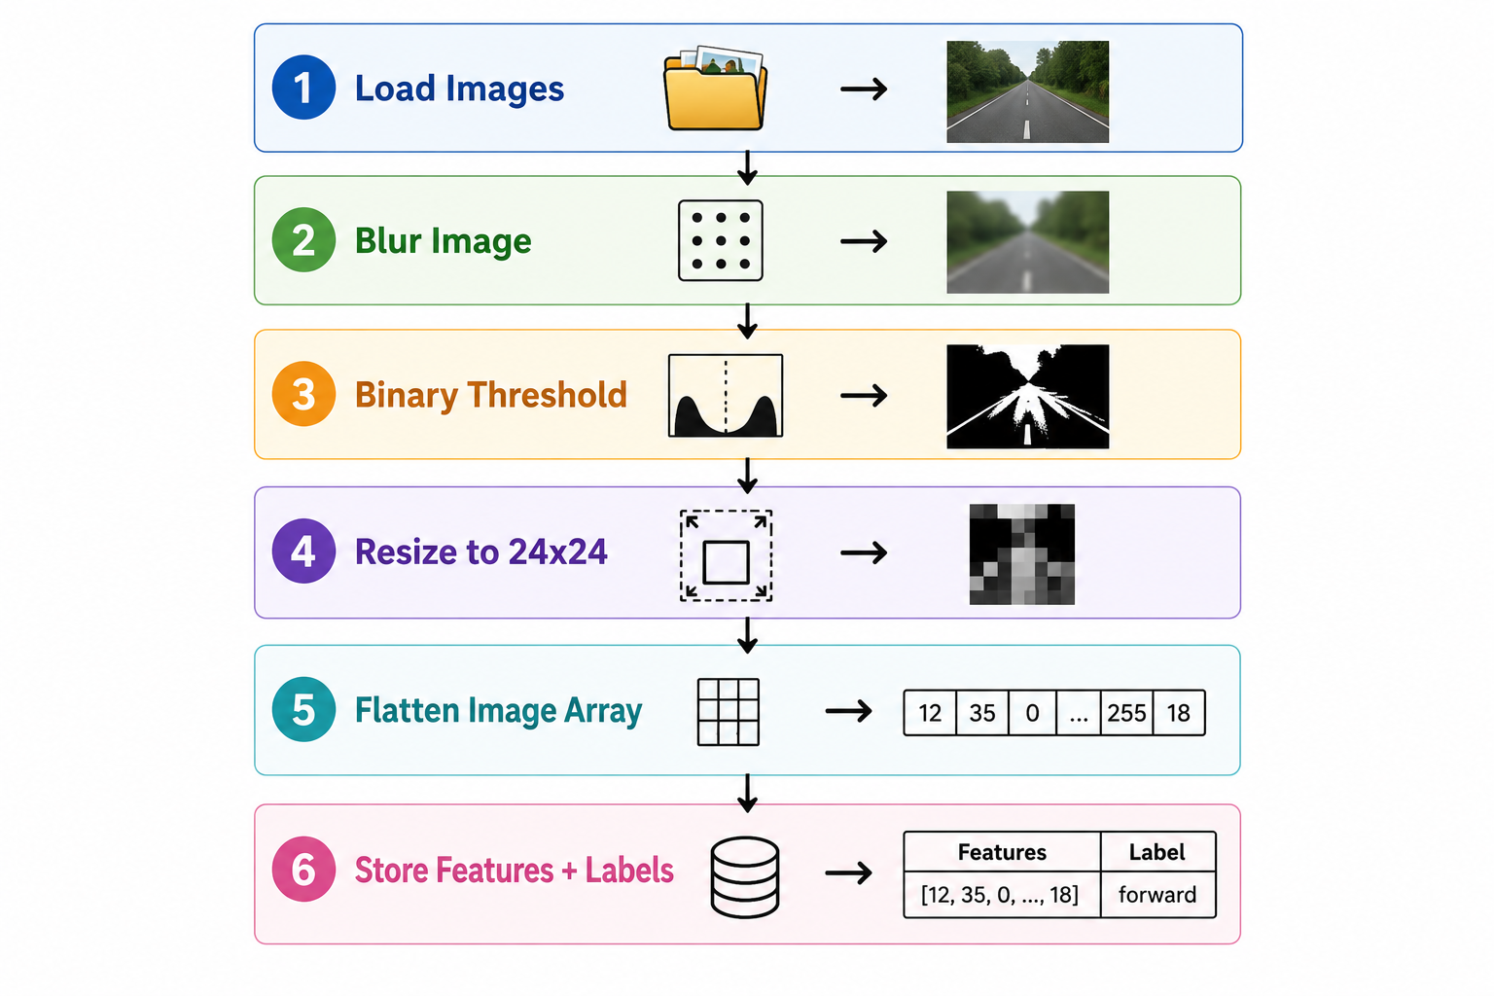
Phase 2 — Dataset Preprocessing Python Training Script Workflow:

Slide 13
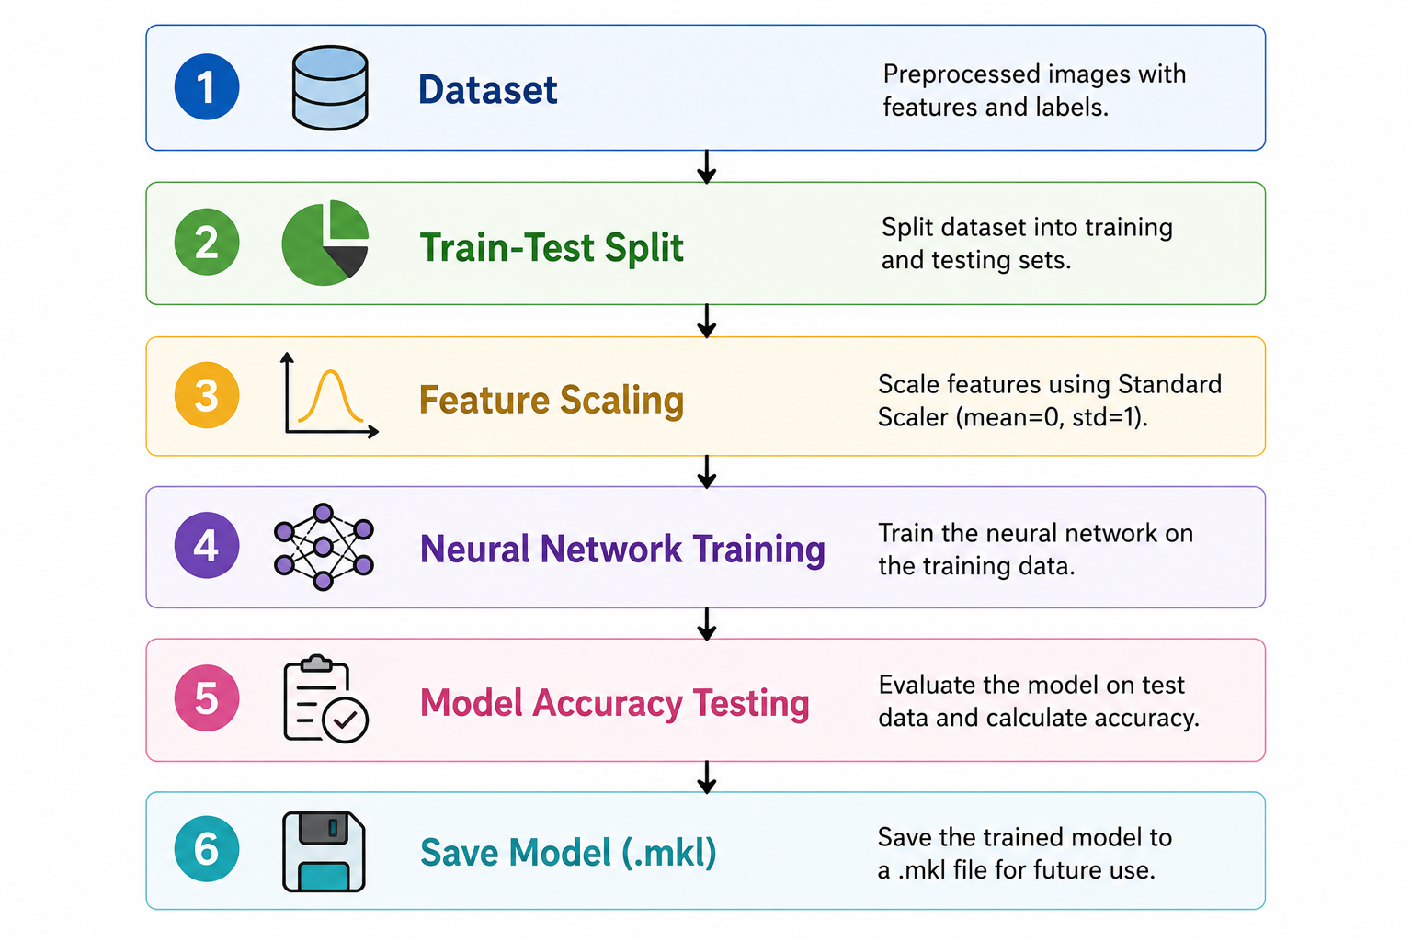
Phase 3 — AI Model Training Algorithm Used: MLP Classifier (Multi-Layer Perceptron Neural Network)

Slide 14
Neural Network Workflow
Input Layer (576 Features) │ ▼ Hidden Layer (50 Neurons) │ ▼ Output Classes: Forward Left Right Stop

Slide 15
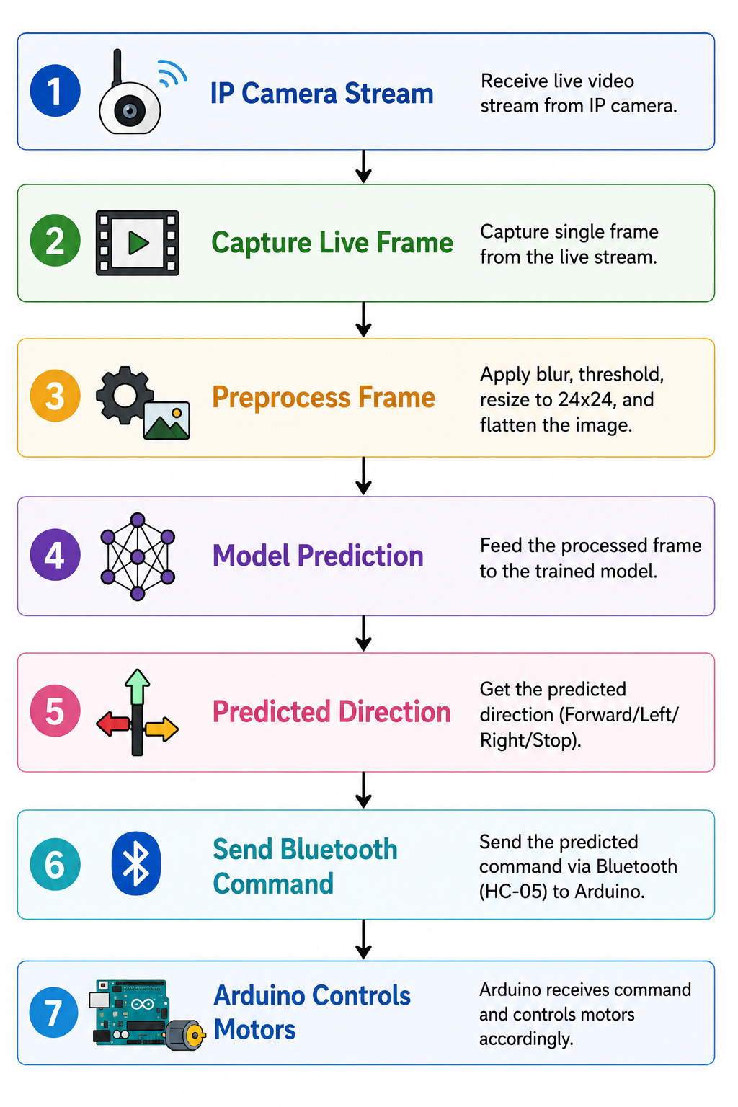
Real Time Workflow

Slide 17
Thank You
Questions & Discussion

